Slide 1
Chapter one Characterization of distributed systems

Slide 2
1.1 Introduction
computer systems are undergoing a revolution
Since 1945 -1985
computers were large and expensive
slow in processing instructions
there was lack of a way to connect them.
operated independently from one another.
Around the mid-1980s, two major developments in technology began to change
development of cheap and powerful microprocessor-based computers (8,16,32 and 64 bits)
the invention of high-speed computer networks(LAN and WAN)
This results introduction of distributed systems

Slide 3
1.2. Definition of Distributed System
Is a collection of independent computers that appears to its users as a single coherent system
It consists of components that are autonomous
users (be the people or programs) think that they are dealing with a single system
Is a system in which hardware or software components located at networked computers communicate and coordinate their actions only by passing messages.
This def. of DS has the following consequences
Concurrency
No global clock
Independent Failure

Slide 4
Concurrency
In computer networks, concurrent program execution is a norm.
I can do my work on my computer while you do your work on yours, sharing resources such as web pages or files when necessary
No global clock
When programs need to cooperate they coordinate their actions by exchanging messages.
There is no single global notion of the correct time, the only communication is by sending messages through a network
Independent failures
Each component of the system can fail independently, leaving the others still running

Slide 5
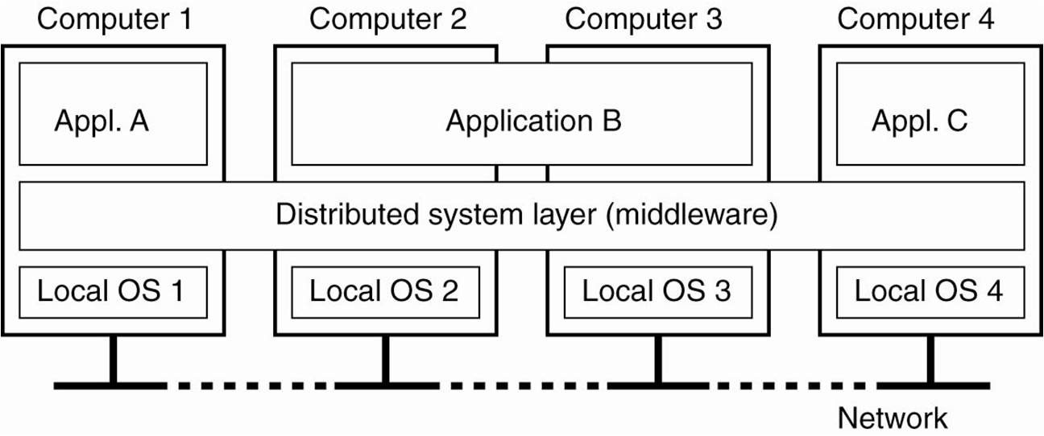
A system designed to support the development of applications and services which can exploit a physical architecture consisting of multiple, autonomous processing elements that do not share primary memory but cooperate by sending asynchronous messages over a communication network.

Slide 6
1.3. Challenges in designing a Distributed System
Heterogeneity:
Users access services and run applications over a heterogeneous collection of computers and networks.
networks, computer hardware, operating systems, programming languages, implementations by different developers.
Middleware: applies to a software layer that provides a programming abstraction as well as masking the heterogeneity of the underlying networks, hardware, operating systems and programming languages. (CORBA: common object request broker and RMI: Java remote method invocation)(implemented in Over the IP)
Internet protocol masks the differences of networks
Programs written by d/t developers use common standards to communicate

Slide 7
Openness:
is determined primarily by the degree to which new resource-sharing services can be added and be made available for use by a variety of client programs.
Security:
has three components: confidentiality (protection against disclosure to unauthorized individuals), integrity (protection against alteration or corruption), and availability (protection against interference with the means to access the resources).
Scalable:
remains effective when there is a significant increase in the number of resources and the number of users

Slide 8
Failure handling
handling of failures is particularly difficult like detecting failures(checksum), masking failures(retransmitting and replicating), tolerating failures(try again later) and recovery from failures(roll back) since systems fail independently
Concurrency
a possibility that several clients can access a shared resource at the same time. These multiple requests may conflict with one another and produce inconsistent results.
Transparency
the system is perceived as a whole rather than as a collection of independent components
Quality of service
Once we provide the users with the functionalities then ask them about the quality of services
Non-functional properties: reliability, security, performance, availability and flexibility

Slide 9
1.4. Goals of Distributed System
Making Resources Accessible
Distribution Transparency
Openness in a Distributed System
Scalability in Distributed Systems
Making Resources easily Accessible
Resources include things like printers, computers, storage facilities, data, files, Web pages, and networks
The reason for sharing resources is economy i.e. to share costly resources such as supercomputers, high-performance storage systems, printers, and other expensive peripherals to make exchange of information easy

Slide 10
Distribution Transparency
to hide the fact that its processes and resources are physically distributed across multiple computers
Transparency | Description
Access | Hide differences in data representation and how a resource is accessed.
Location | Hide where a resource is physically located.
Migration | Hide that a resource may move to another location.
Relocation | Hide that a resource may be moved to another location while in use.
Replication | Hide that a resource is replicated.
Concurrency | Hide that a resource may be shared by several competitive users.
Failure | Hide the failure and recovery of a resource.

Slide 11
Openness in a Distributed System
An open distributed system is a system that offers services according to standard rules that describe the syntax and semantics of those services.
In computer networks, standard rules govern the format, contents, and meaning of messages sent and received(protocols)
In distributed systems, services are generally specified through interfaces, which are often described in an Interface Definition Language (IDL)
Extensibility, interoperability and portability are also goals for open distributed system.
portability :an application developed for a distributed system A can be executed without modification, on a different distributed system B that implements the same interfaces as A.
Interoperability: the extent by which two implementations of systems or components from different manufacturers can co-exist and work together by merely relying on each other's services.

Slide 12
Scalability in Distributed Systems
Distributed systems operate effectively and efficiently at many different scales, ranging from a small intranet to the Internet.
A Distributed System is described as scalable if it will remain effective when there is a significant increase in the number of resources and the number of users
Allows the system and applications to expand in scale without change to the system structure or the application algorithms.
Scalability
can easily add more users and resources to the system
geographically scalable system is one in which the users and resources may lie far apart.
system can be administratively scalable, spanning that it can still be easy to manage even if it spans many independent administrative organizations
Techniques to achieve scalability includes
Scaling up, hiding the communication, partitioning and distribution, replication, catching

Slide 13
1.5. Types of Distributed System
Distributed Computing Systems
Distributed Information Systems
Distributed Pervasive Systems
Distributed Computing Systems
used for high-performance computing tasks
Cluster computing
Grid computing
Cloud computing

Slide 14
Cluster computing
consists of a collection of similar workstations or PCs (homogeneous), closely connected by means of a high speed local-area network
each node runs the same operating system
used for parallel programming in which a single compute intensive program is run in parallel on multiple machines
compute nodes of each cluster are controlled and accessed by means of a single master node
The master
handles the allocation of nodes to a particular parallel program,
maintains a batch queue of submitted jobs, and provides an interface for the users of the system
runs the middleware needed for the execution of programs and management of the cluster

Slide 16
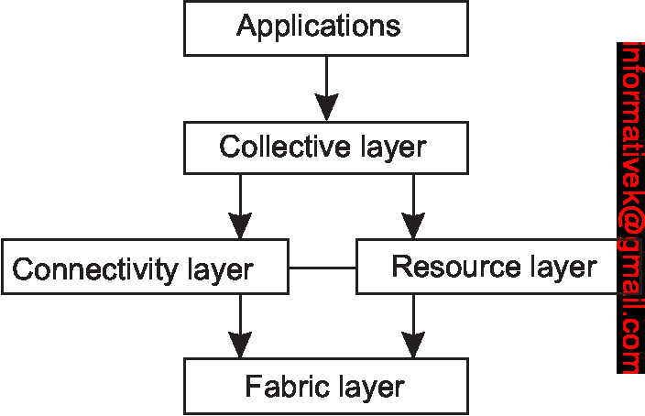
Grid computing
consists of distributed systems that are often constructed as a federation of computer systems
high degree of heterogeneity: no assumptions are made concerning hardware, operating systems, networks, administrative domains, security policies, etc.
resources from different organizations are brought together to allow the collaboration of a group of people or institutions.
A layer architecture for a grid computing system

Slide 17
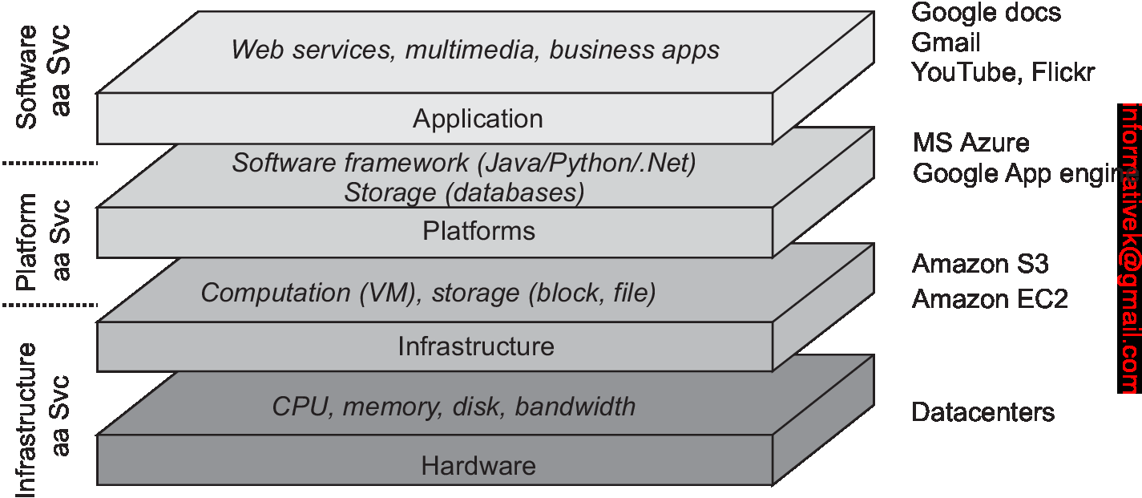
Cloud computing
Simply outsource the entire infrastructure that is needed for compute-intensive applications
proving the facilities to dynamically construct an infrastructure and compose what is needed from available services.
Unlike grid computing, which is strongly associated with high-performance computing, cloud computing is much more than just proving lots of resources.
Cloud-computing providers offer these layers to their customers through various interfaces ( CL tools, Programming Interfaces and web interfaces), leading to three different types of services:
IaaS –covering hardware and Infrastructure layer
PaaS-covering the platform layer
SaaS in which their applications are covered
The organization of clouds

Slide 18
Distributed Information Systems
a networked application simply consisted of a server running that application and making it available to remote programs (clients)
Clients send requests and get responses from the server
Transaction processing systems
operations on a database are usually carried out in the form of transactions
Primitive | Description
BEGIN_TRANSACTION | Mark the start of a transaction
END_TRANSACTION | Terminate the transaction and try to commit
ABORT_TRANSACTION | Kill the transaction and restore the old values
READ | Read data from a file, a table, or otherwise
WRITE | Write data to a file, a table, or otherwise

Slide 19
Transactions properties:
Atomic: a transaction either happens completely or not at all
Consistent: the transaction does not violate system invariants
Isolated: concurrent transactions do not interfere with each other
Durable: once a transaction commits, the changes are permanent

Slide 20
Distributed Pervasive Systems
The last 2 types of DS are characterized by their stability; fixed nodes having high-quality connection to a network.
DPS include mobile and embedded computing devices which are small, battery-powered, mobile, and with a wireless connection.
instability is their default behavior
three requirements for pervasive applications:
Embrace contextual changes: a device is aware that its environment may change all the time,
Encourage ad hoc composition: devices are used in different ways by different users
Recognize sharing as the default: devices join a system to access or provide information
Ex. Home systems, E-Healthcare system etc

Slide 21
1.6. Common mistakes
Developing distributed systems is different than developing non-distributed ones.
Developers with no experience typically make a number of false assumptions when first developing distributed applications.
All of these assumptions hold for non-distributed systems, but typically do not hold for distributed systems.
The network is reliable
Latency is zero
Bandwidth is infinite
The network is secure
The topology does not change
There is one administrator
Transport cost is zero
Everything is homogeneous

Slide 22
End of chapter 1!
Questions?

